Slide 1
DISASTER DETECTION
PIP4004 Capstone Project
VIVA VOICE
Batch Number:ISD-02
Roll Number | Student Name
20211ISD0030 | A Shabarriesh
20211ISD0009 | A V Rohith Kumar
20211ISD0035 | M B V Sandeep Reddy
Under the Supervision of,
Dr. Sampath A K
Professor
School of Computer Science and Engineering&IS
Presidency University
Name of the Program: ISD
Name of the HoD: PALLAVI R
Name of the Program Project Coordinator: Mr.Srinivas Mishra
Name of the School Project Coordinators: Dr. Sampath A K / Dr. Abdul Khadar A / Mr. Md Ziaur Rahman

Slide 2
Introduction
Natural disasters have far-reaching consequences, impacting lives, infrastructure, and the environment. To mitigate the damage and enhance disaster preparedness, technology can play a pivotal role in early detection and efficient management. This project focuses on disaster prediction, aiming to detect high probabilities of large-scale natural disasters by processing satellite data alongside human-generated inputs. The system utilizes this data to not only predict the likelihood of imminent disasters but also model the dynamics of post-disaster spread. By understanding these patterns, decision-makers can improve disaster management, leading to timely responses and resource allocation during crises.This project aims to predict the likelihood of large-scale disasters by processing satellite and human-generated data. By using this data, the system can serve as an early warning tool while also modeling the post-disaster spread dynamics, which is crucial for effective disaster management.

Slide 3
Literature Survey
S.No | Author(s) | Title | Year | Methodology | Inferences | Merits | Demerits
1 | Vinay Chamola , Vikas Hassija , Sakshi Gupta , Adit Goyal , Mohsen Guizani , and Biplab Sikdar | Disaster and Pandemic Management Using Machine Learning: A Survey | 2021 | Machine Learning, Neural Networks | Machine learning can accurately predict natural disasters | High prediction accuracy, Quick response time | Requires large, high-quality datasets
2 | Harshita Jain Renu Dhupper Anamika Shrivastava Deepak Kumarand Maya Kumari | Leveraging machine learning algorithms for improved disaster preparedness and response through accurate weather pattern and natural disaster prediction | 2023 | Predictive Analytics Disaster Prediction | Satellite data enhances early warning for disasters | Real-time monitoring, Covers large geographical areas | Expensive infrastructure, Dependent on satellite availability
3 | Alaa Taiseer Farghaly Ngahzaifa Binti Ab Ghani Abbas Saliimi Lokman | A Review on Disaster Prediction Using Machine Learning | 2024 | Predictive Analytics | Predictive models can reduce the impact of flood disasters | Early detection, Reduced risk of property damage | IoT sensor network setup is costly, Requires constant monitoring

Slide 4
Literature Survey
S.No | Author(s) | Title | Year | Methodology | Inferences | Merits | Demerits
4 | Paul Michael Z Labis | Machine Learning for Disaster Risk Reduction - Review and Research Directions | 2024 | Disaster Prediction Early Warning Sysytem Resource Allocation | ML models show promising results in predicting earthquakes | Faster and more reliable earthquake predictions | Limited by current data sources, False alarms
5 | Md Fakhrul Islam Sumon,Azam Khan,Arifur Rahman,Dileep Kumar Chikwarti | Machine Learning for Real-Time Disaster Response and Recovery in the U.S | 2023 | Machine Learning, Natural Language Processing Supervised and un Supervised learning | Big data improves the ability to forecast disasters | Better decision-making for disaster preparedness | Computationally intensive, Requires vast data storage
6 | Qingsong Xu1 Yilei Shi2 Xiao Xiang Zhu1 | DISASTERNETS: EMBEDDING MACHINE LEARNING IN DISASTER MAPPING | 2023 | Supervised/Semi Supervised Deep Learning Unsupervised Learning and Domain Adaptation | better map disaster-prone regions | Helps in resource allocation and Open Accessibility evacuation planning | difficult to collect and interpret Data Quality

Slide 5
Literature Survey
S.No | Author(s) | Title | Year | Methodology | Inferences | Merits | Demerits
7 | Not Given | Leveraging AI for Natural Disaster Management : Takeaways From The Moroccan Earthquake | 2023 | Machine Learning, Climate Data Analysis Damage assessment | Machine learning models provide early warnings for cyclones | High accuracy in predicting cyclones, Saves lives | Data collection for training models is challenging
8 | Vasileios Linardos Maria Drakaki Panagiotis Tzionas and Yannis L arnavas | Machine Learning in Disaster Management: Recent Developments in Methods and Applications | 2022 | Risk and Vulnerability Assessment Disaster Monitoring | Ml can be used to predict earthquake, Hurricane and Floods | Faster response to wildfires, Minimizes damage | Dependent on environmental data quality and sensor precision
9 | R. Kumar, T. Wang | Earthquake Prediction Using Neural Networks | 2021 | Neural Networks, Seismic Analysis | Neural networks can predict earthquakes within time windows | Increased preparedness, Timely alerts | High false-positive rates, Prediction accuracy varies

Slide 6
Objectives
The primary objective of this project is to develop a system that predicts large-scale natural disasters, such as hurricanes, floods, earthquakes, by processing satellite and human-generated data. The system aims to provide real-time monitoring and issue timely alerts to ensure early detection and intervention. Additionally, it seeks to model the post-disaster spread dynamics. By integrating diverse data sources, the system will enhance the accuracy of predictions, supporting decision-makers in planning evacuations, resource management, and disaster recovery. Ultimately, the goal is to minimize the social, environmental, and economic impacts of natural disasters while creating a scalable and adaptable framework that can be applied to various disaster scenarios globally.

Slide 7
Proposed Method
The proposed method involves two key phases: disaster prediction and post-disaster spread modeling. In the prediction phase, satellite data will be processed using machine learning algorithms to detect patterns that indicate the likelihood of large-scale natural disasters, such as hurricanes, earthquakes, or floods. This analysis will be complemented by human-generated data, such as social media posts, sensor readings, and local reports, to increase the accuracy and timeliness of the predictions.
Once a potential disaster is identified, the second phase will focus on modeling the spread dynamics of the disaster's impact. This will involve simulating the progression of the disaster using both historical data and real-time inputs. The model will take into account factors like geographical conditions, population density, and infrastructure to estimate the areas most affected. The combined data-driven insights will help authorities not only predict but also manage disaster scenarios, providing tools for efficient evacuation planning, resource allocation, and damage mitigation.

Slide 8
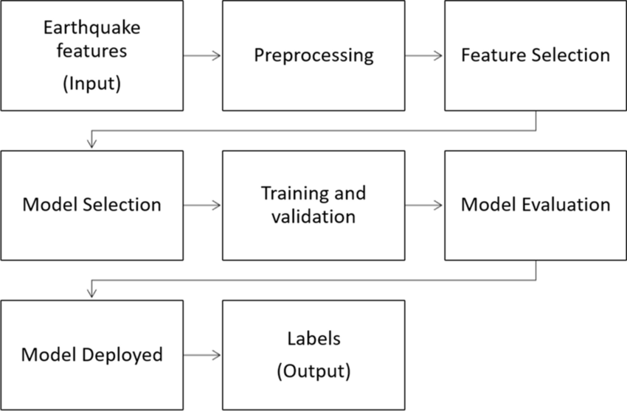
Architecture Diagram

Slide 9
Modules
1. Data Collection and Aggregation Module
Objective: To gather and consolidate data from multiple sources including satellite imagery, sensor networks, and human-generated inputs like social media, reports, and crowdsourced information.
Tasks:
Access real-time and historical satellite data.
Collect data from ground sensors and online platforms.
Aggregate human-generated reports, social media activity, and news articles relevant to disasters.
Ensure data integrity, format consistency, and proper labeling for further analysis.
2. Data Preprocessing and Cleaning Module
Objective: To clean and transform raw data into a usable format for analysis and machine learning models.
Tasks:
Handle missing, noisy, or inconsistent data.
Perform normalization, transformation, and feature extraction.
Synchronize data timestamps across satellite and human-generated data sources.
Label data points for training and validation purposes. Objective: To offer strategic insights for authorities to manage disaster response efficiently.
Tasks:
Analyze data from disaster predictions and spread models to assist decision-makers.
Provide visual reports and risk assessments for disaster management.
Recommend resource distribution and evacuation planning based on real-time and forecasted data.

Slide 10
Modules
Disaster Prediction Model Module
Objective: Predict the likelihood of disasters using machine learning algorithms.
Tasks:
Train models using historical disaster patterns.
Implement algorithms such as CNNs or Random Forest to predict disasters.
Continuously update and refine models for real-time predictions.
4. Data Fusion Module
Objective: Combine satellite and human-generated data to enhance prediction accuracy.
Tasks:
Fuse diverse data inputs to create a comprehensive dataset.
Weigh data sources by relevance and credibility.
Improve prediction confidence by integrating various data types. Post-Disaster Spread Dynamics Module
Objective: Model the spread of disaster impacts to assist in post-event management.
Tasks:
Simulate disaster impact progression based on real-time inputs.
Consider geographic, infrastructure, and population factors.
Provide dynamic models to predict disaster spread over time.
6. Monitoring and Alert Module
Objective: Offer real-time monitoring and issue alerts when disaster likelihood increases.
Tasks:
Display real-time predictions and spread models on a dashboard.
Set thresholds for issuing alerts to authorities and the public.
Implement multi-channel alert mechanisms for timely warnings.

Slide 11
Hardware and Software Details
Hardware and Software Details
Hardware Requirements
Processor: Multi-core (e.g., Intel Xeon, AMD Ryzen)
RAM: Minimum 8 GB
Storage: SSD, at least 512GB
Network: High-speed internet (100 Mbps or more)
Software Requirements
Operating System: Windows Server
Programming Languages:
Development Tools:
Machine Learning
Libraries: Random Forest, Matplotlib, Pandas
Options: MySQL or PostgreSQL (SQL) for structured data, and MongoDB (NoSQL) for unstructured data.

Slide 12
Methodology
The methodology for the disaster prediction and post-disaster spread dynamics project involves several key steps, integrating data collection, processing, modeling, and evaluation:
Data Collection:
Satellite Imagery: Utilize remote sensing technology to gather real-time and historical satellite data related to environmental factors (e.g., temperature, precipitation, vegetation cover) that can indicate potential disasters.
Human-Generated Data: Aggregate data from social media platforms, news reports, and crowdsourced information to capture public sentiment and reports related to disasters.
Ground-Based Sensors: Deploy IoT sensors to collect real-time environmental data, such as weather conditions, seismic activity, and air quality.
Data Preprocessing:
Data Cleaning: Implement techniques to clean and filter the collected data, removing noise and inconsistencies. Handle missing values and ensure uniformity across different data formats.
Data Normalization and Transformation: Normalize the data to ensure consistency and transform it into suitable formats for analysis and model training.
Disaster Prediction Model Development:
Feature Engineering: Identify and extract relevant features from the processed data that contribute to predicting disaster occurrences. This includes historical trends and environmental indicators.
Model Selection and Training: Utilize machine learning algorithms (e.g., Random Forest, Support Vector Machines, Convolutional Neural Networks) to train models on historical disaster data. Split the data into training, validation, and test sets to evaluate model performance.
Real-Time Data Integration: Implement a mechanism to continuously feed real-time data into the prediction models, allowing for dynamic updates and improved accuracy.

Slide 13
Methodology
Simulation Models: Develop simulation models to predict how a disaster spreads based on real-time data inputs and geographical features. Use mathematical and computational techniques to model the dynamics of the disaster's impact.
Geospatial Analysis: Employ geospatial analysis tools to assess factors such as terrain, population density, and infrastructure, which influence the spread and severity of the disaster.
Monitoring and Alert System Implementation:
Dashboard Development: Create a real-time dashboard for visualizing disaster predictions and spread models, enabling decision-makers to monitor risks effectively.
Alert Mechanism: Establish an alert system that issues notifications based on predefined thresholds and triggers, ensuring timely communication of potential disasters to the relevant authorities and communities.
Evaluation and Validation:
Model Performance Assessment: Evaluate the performance of prediction models using metrics such as accuracy, precision, recall, and F1 score. Validate models against historical disaster events to ensure reliability.
Scenario Testing: Conduct scenario-based testing to assess how the system performs under different disaster conditions and to refine the models based on these insights.
Deployment and Continuous Improvement:
System Deployment: Deploy the system in a real-world environment, integrating it with local emergency management frameworks and disaster response teams.
Feedback Loop: Implement a feedback mechanism to continuously gather data on system performance and user experiences, allowing for ongoing improvements and refinements of models and processes.

Slide 14
Timeline of Project
Data Collection & Analysis (Weeks 1-2):
Gather user interaction data from the e-commerce app.
Data Preprocessing (Weeks 3-4):
Clean and prepare the collected data for analysis.
Intent Prediction Model Development (Weeks 5-6):
Develop and train the machine learning model to predict user intent.
Notification Management System Design (Weeks 6-7):
Design the system to manage when and how notifications are sent based on intent detection.
Real-Time Monitoring & A/B Testing (Weeks 7-8):
Implement monitoring tools and conduct A/B testing to refine notification strategies.
User Feedback Integration (Weeks 9-10):
Incorporate user feedback mechanisms to improve notification relevance.
Final Testing & Deployment (Week 10):
Test the entire system and prepare for deployment to users.

Slide 15
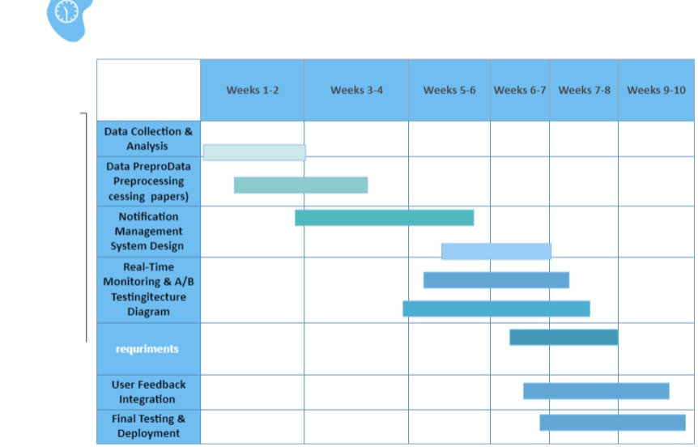
GHANT CHART

Slide 16
Expected Outcomes
The project is expected to significantly enhance disaster management by integrating diverse data sources and leveraging advanced predictive algorithms.
This will enable proactive decision-making, allowing authorities to take preemptive measures such as evacuations or resource mobilization before disasters strike.
The real-time alert system will empower communities with critical information, reducing the loss of life and property. Additionally, the post-disaster modeling will provide valuable insights into the progression of a disaster, helping in efficient resource allocation and timely response to affected areas. By simulating disaster spread, the system will support recovery efforts, optimize rescue operations, and ensure a more structured and informed approach to disaster relief.
This project also aims to provide a scalable and flexible framework that can be adapted to different types of disasters and geographic regions, enhancing global disaster preparedness and response strategies.
The expected outcomes of this project include the development of an accurate disaster prediction system that utilizes machine learning to predict natural disasters such as floods, earthquakes, and wildfires by processing satellite imagery, sensor data, and human-generated inputs.
This system will provide early warnings, helping authorities and communities mitigate the effects of disasters. Additionally, the project will result in a real-time monitoring dashboard that continuously tracks disaster risks, offering dynamic updates and issuing timely alerts to improve preparedness. The system will also model post-disaster spread dynamics, allowing for better resource allocation and management of disaster recovery efforts.

Slide 17
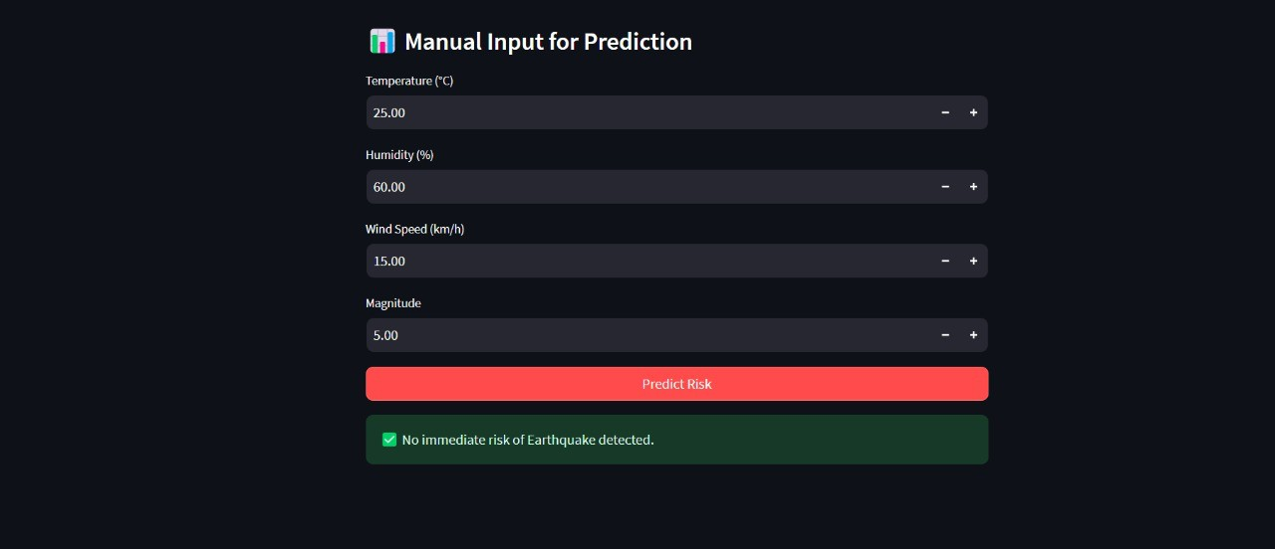
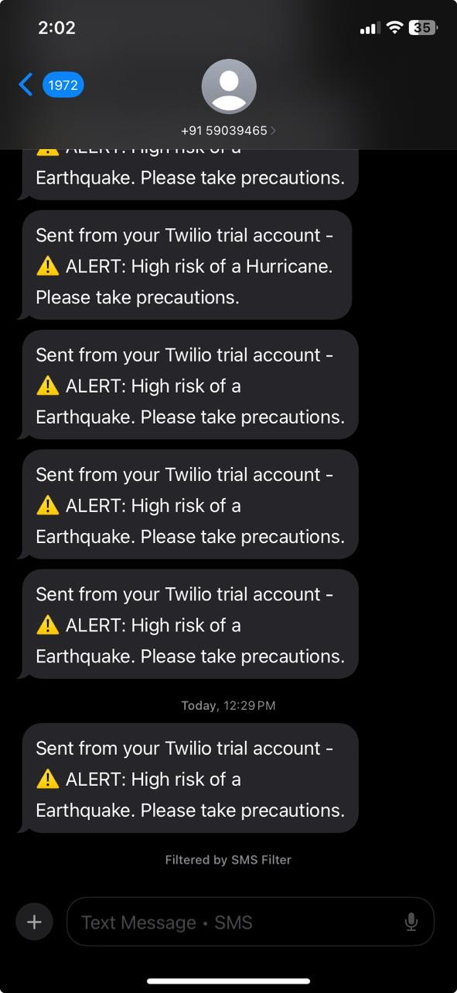
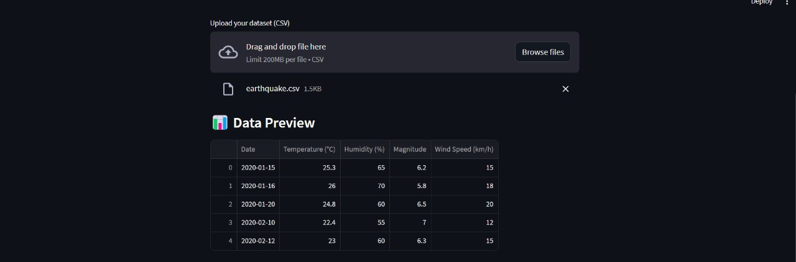
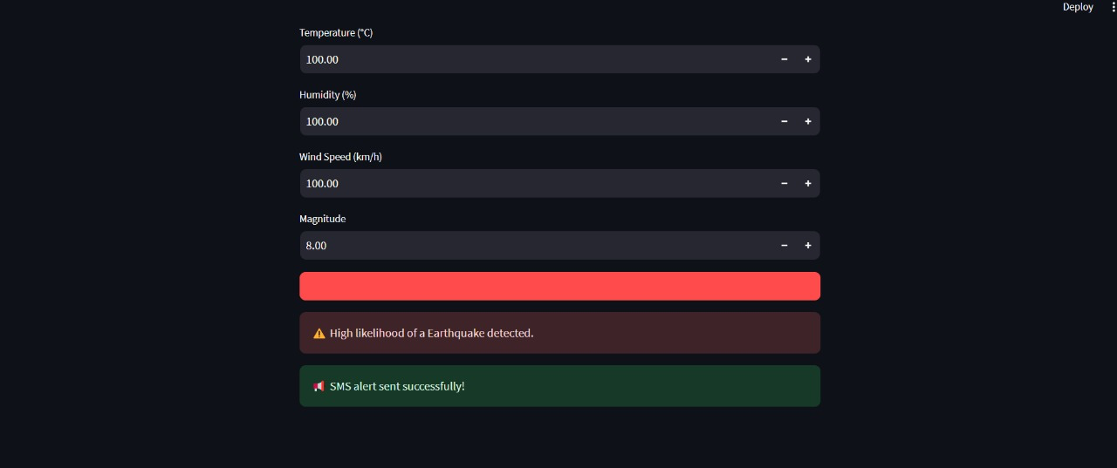
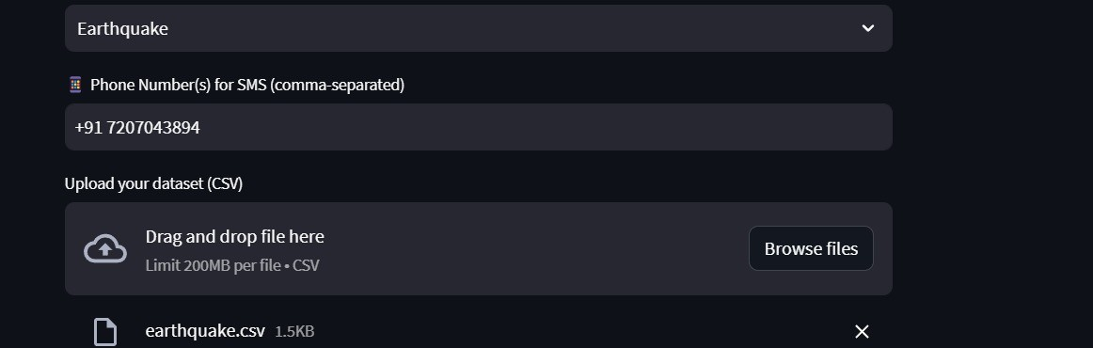
Results

Slide 18
Conclusion
In conclusion, this project aims to develop an innovative disaster prediction and post-disaster management system that leverages satellite data, sensor inputs, and human-generated information to accurately forecast large-scale natural disasters. By integrating machine learning and geospatial analysis, the system will provide real-time monitoring, timely alerts, and comprehensive models of disaster spread dynamics, aiding in effective disaster preparedness and management. The solution is designed to support authorities in making data-driven decisions, optimize resource allocation, and minimize the social, environmental, and economic impacts of disasters. With its scalable and adaptable framework, this project holds the potential to improve global disaster response strategies and reduce the devastation caused by natural disasters in various regions.
Accurate Disaster Prediction: The system will use machine learning to process satellite and sensor data, enabling early detection of natural disasters like floods, earthquakes, and wildfires.
Post-Disaster Spread Modeling: The project will model how disasters spread, helping authorities manage resources, plan evacuations, and optimize recovery efforts.
Scalable and Adaptable Framework: The solution will be scalable, adaptable to different disaster types and regions, enhancing global disaster response and management.

Slide 19
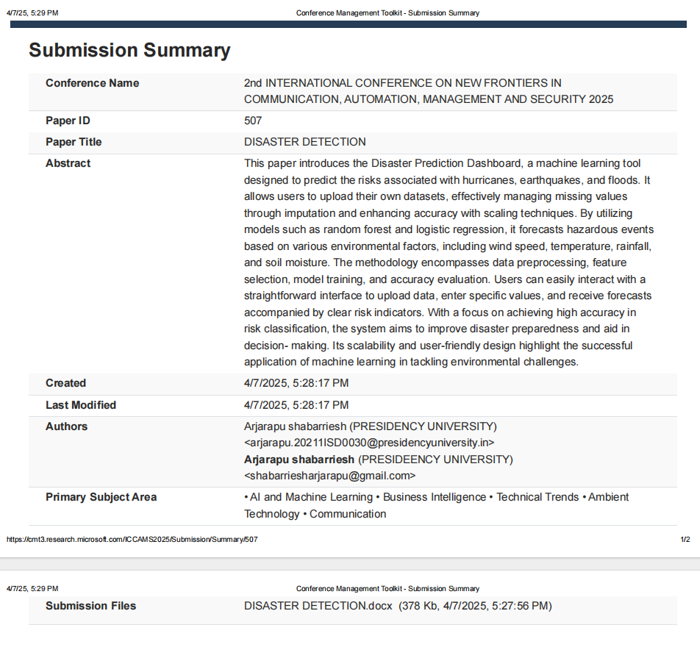
Publications

Slide 20
References
Vinay Chamola , Vikas Hassija , Sakshi Gupta , Adit Goyal , Mohsen Guizani , and Biplab Sikdar ,Disaster and Pandemic Management Using Machine Learning: INTERNET OF THINGS JOURNAL, VOL. 8, NO. 21, NOVEMBER 1, 2021
Jain H, Dhupper R, Shrivastava A, Kumar D and Kumari M , Leveraging machine learning algorithms for improved disaster preparedness and response through accurate eather pattern and natural disaster prediction. Front. Environ. Sci. 11:1194918. doi: 0.3389/fenvs.2023.1194918(2023)
A Review on Disaster Prediction Using Machine Learning Alaa Taiseer Farghaly1* , Ngahzaifa Binti Ab Ghani2 , Abbas Saliimi Lokman ISSN: 2073-607X, 2076-0930 , 16(S1)2024
Labis, Paul Michael. Machine Learning for Disaster Risk Reduction - Review and Research Directions. (2024).
Fakhrul, Md & Sumon, Md Fakhrul Islam & Khan, Azam & Rahman, Arifur & Chikwarti, Dileep Kumar. (2023). Machine Learning for Real-Time Disaster Response and Recovery in the U.S. 14.
Qingsong Xu1 , Yilei Shi2 , Xiao Xiang Zhu ‘Role of Internet of Things in disaster management’, Proceedings of 2017 International Conference on Innovations in Information, Embedded and Communication Systems, ICIIECS 2017, 2018- Janua(September), pp. 1–4. doi: 10.1109/ICIIECS.2017.8275928.(2023)
Leveraging AI for Natural Disaster Management : Takeaways From The Moroccan Earthquake 2023
Linardos, V.; Drakaki, M.; Tzionas, P.; Karnavas, Y.L. Machine Learning in Disaster anagement: Recent Developments in Methods and Applications. Mach. Learn. Knowl. Extr. 2022, 4, 446–473. https://doi.org/10.3390/ make4020020

Slide 21


